Slide 1
Pharmacology of the Cardiovascular System
Thrombosis
Dr Ken Wojcikowski

Slide 2
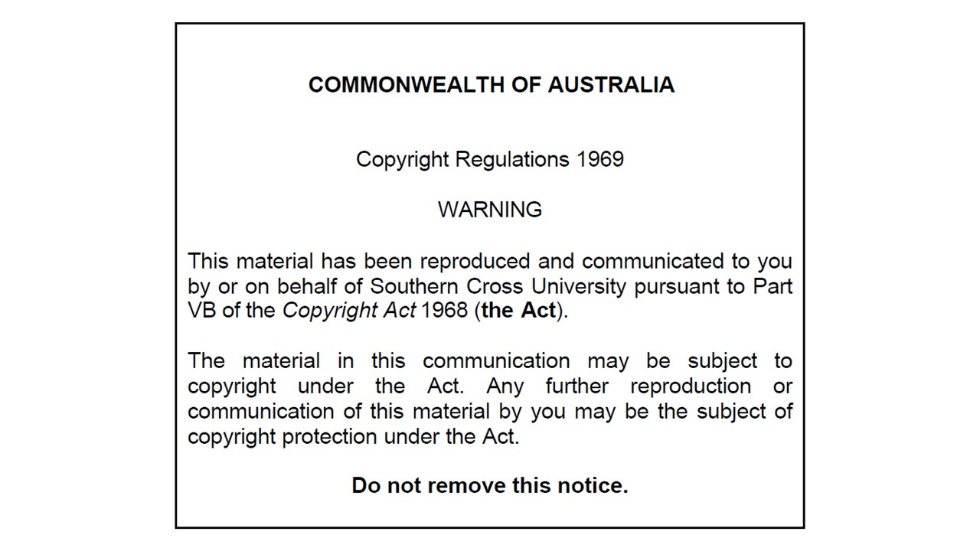

Slide 3
Objectives for this portion of the chapter
Explain the various steps involved in thrombus formation
Explain how each of our medications that decrease thrombus formation affect one of the steps involved in thrombus formation,
Identify and explain the actions of common pharmacological agents used to prevent the development of a thrombus.

Slide 4
kjhkjhlkdfs
Medications of the Cardiovascular System:
Thrombosis
Lesson 1:
Understanding the foundational information about haemostasis

Slide 5
Thrombus
Plural form = thrombi
Process of thrombus formation = thrombosis
A thrombus is a blood clot

Slide 6
Haemostasis
The process of haemostasis involves:
Vessel spasm
Formation of the platelet plug
Blood coagulation or development of an insoluble fibrin clot
Clot retraction
Clot dissolution

Slide 7
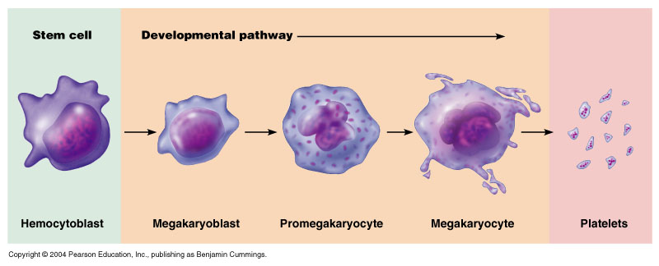
Differentiation of precursor cells to platelets
Pearson Education

Slide 8
Platelets contain:
Contractile proteins including actin and myosin
Mitochondria that produce ADP
Preformed enzymes that synthesise prostaglandins
    Cyclooxygenase (COX) synthesises pro-platelet prostaglandin TXA2; thromboxane A2 (intact endothelium contains PGI2; prostacyclin)
Growth factors that repair damage to endothelium

Slide 9
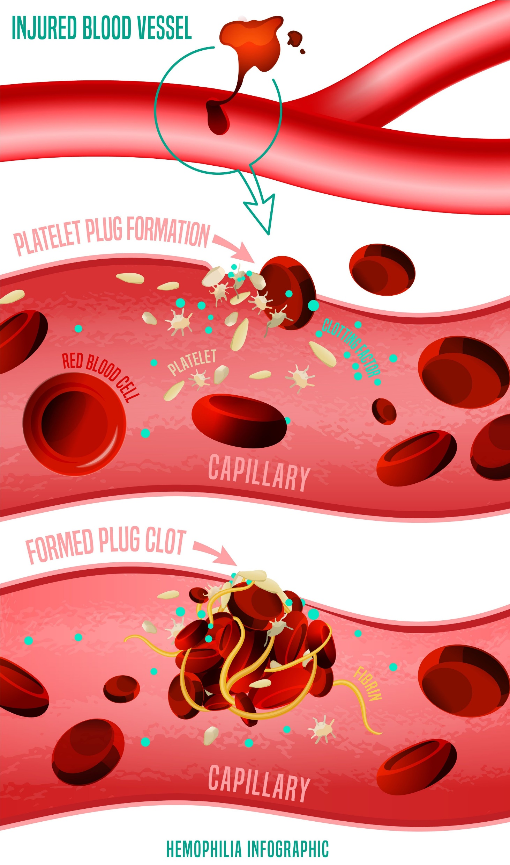
.

Slide 10
Endothelial damage causes change in charge
Von Willebrand factor attracts platelets as well
.

Slide 11
Fibrin meshwork changes the platelet plug into a blood clot
.

Slide 12
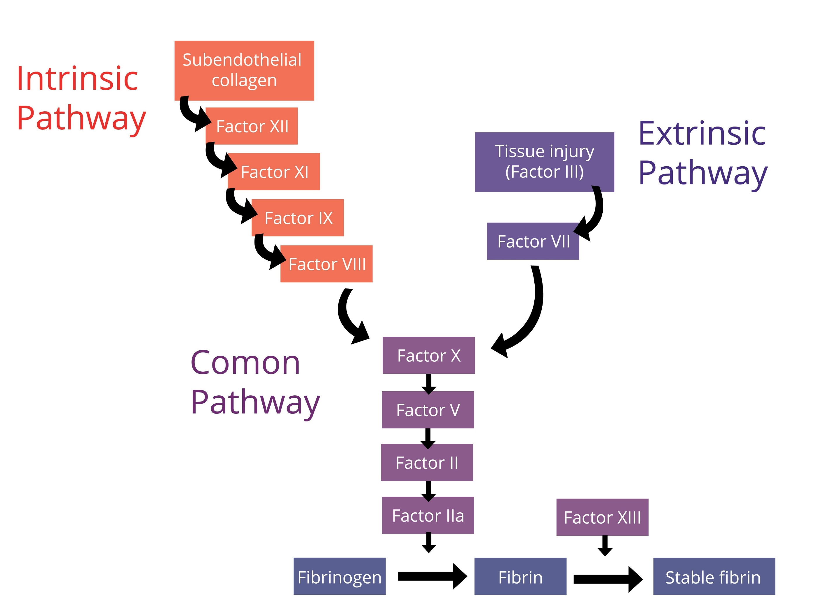
The clotting cascade

Slide 13
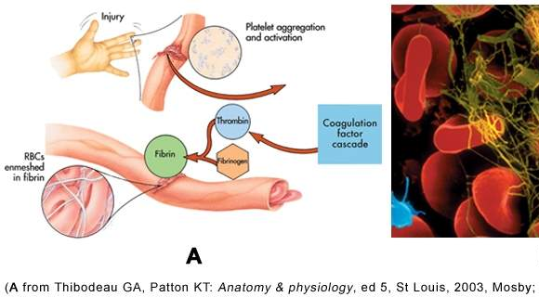
The clotting cascade

Slide 14
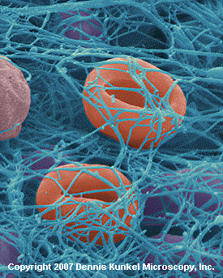
Fibrin

Slide 15
Ultimately, plasminogen changes to plasmin which degrades the clot

Slide 16
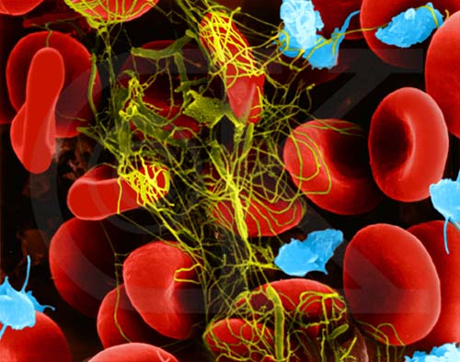
Arterial Clot
http://www.treehugger.com/files/2007/09/how_air_pollution.php

Slide 17
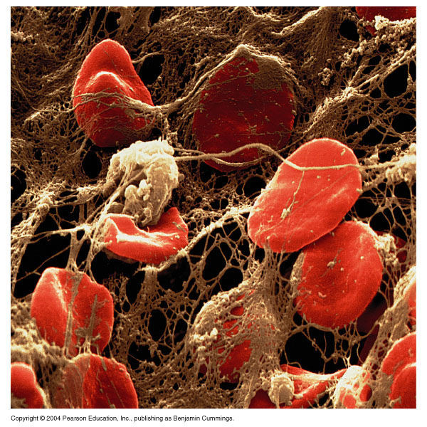
Venous Clot
Pearson Education

Slide 18
kjhkjhlkdfs
Medications of the Cardiovascular System:
Thrombosis
Lesson 2:
Antiplatelet drugs

Slide 19
Antiplatelet drugs: Aspirin aka acetylsalicylic acid (ASA)
Aspirin used long-term to help prevent further heart attacks, ischaemic strokes, and arterial blood clots in people at high risk.
Aspirin works similarly to other NSAIDs but also affects platelets
The bark of the willow tree containing ASA has been used for its health effects for at least 2,400 years.
Clopidogrel is taking over as preferred antiplatelet drug
  Can be combined with aspirin

Slide 20
Antiplatelet drugs: Aspirin
PGI2 from intact epithelium and TXA2 from platelets normally balance to form ideal haemostasis
  This balance is disrupted when the intact epithelium is covered in atherosclerotic plaques, making the pro-platelet TXA2 dominate
The acetyl group in aspirin non competitively inhibits cyclooxygenase (COX), needed to form TXA2.
Thromboxane (TXA2) is therefore not able to be made for the entire 9 day life of the platelet.
  Balance is restored
  Intact endothelium contains PGI2; prostacyclin but the endothelial cells can synthesise more enzyme while platelets cannot

Slide 21
Aspirin as an antiplatelet drug
Low dose aspirin (75-150 mg/day) is proven effective in reducing MI and strokes from atherosclerosis
Adverse effects
  Stomach ache, stomach ulcers, allergies
Q: I am healthy, and my arteries should be clean, why don’t I bleed readily when I take aspirin?
  A: Aspirin doesn’t destroy platelets, it takes away one of their ‘tools’. Also, not all platelets are affected.

Slide 22
Clopidogrel
Clopidogrel is emerging as the preferred antiplatelet medication
Decreases risk of heart attack and stroke
Its effect starts about two hours after intake and lasts for five days.
Common side effects include headache, nausea, easy bruising, itching, and heartburn.
Rarely causes thrombotic thrombocytopenic purpura.
Works by irreversibly inhibiting a receptor called P2Y12 for ADP on platelets.

Slide 23
kjhkjhlkdfs
Medications of the Cardiovascular System:
Thrombosis
Lesson 3:
Anticoagulants

Slide 24
Anticoagulants
Anticoagulants, commonly known as blood thinners, but do not affect the viscosity of blood
Prevent or reduce coagulation of blood, prolonging the clotting time.
Used for both arterial and venous clots
One of the first anticoagulants, warfarin
  Component from sweet clover
    First developed as a poison: rat bait

Slide 25

Simplistic look at the mechanism by which warfarin works
Clotting factors need fresh or recycled vitamin K to be made
Vitamin K becomes inactive when making clotting factor
Vitamin K is recycled with epoxide reductase

Slide 26
Simplistic look at the mechanism by which warfarin works
Clotting factors need fresh or recycled vitamin K to be made
Vitamin K becomes inactive when making clotting factor
Vitamin K is recycled with epoxide reductase
Warfarin inhibits epoxide reductase, not allowing Vitamin K to be recycled

Slide 27
Drugs that affect coagulation
Warfarin
Taken orally, absorbed quickly
Takes several days to exert its effect (there is still active vitamin K hanging around)
Affects several clotting factors
Warfarin inhibits epoxide reductase, an enzyme that recycles vitamin K back to its active form
Without active vitamin K, many coagulation factors are missing, resulting in decreased coagulation and if excessive, bleeding

Slide 28
Drugs that affect coagulation
Warfarin (continued)
Dose is extremely variable (2-20mg/day) and requires frequent assessment of coagulation (INR tests need to be performed to make sure of ideal clotting)
Huge number of drugs, dietary factors affect its efficacy
Side effects
  Allergy, bruising, excessive bleeding
  WARFARIN IS TEROTAGENIC
    (contraindicated in women of child bearing age)

Slide 29
Drugs that affect coagulation
Rivaroxaban
An oral anticoagulant
Has fewer side effects than warfarin but greater chance of GIT bleeding
Works by blocking activity of clotting factor Xa
Pregnancy category C

Slide 30
Drugs that affect coagulation
Low molecular weight heparins
Injected subcutaneously like heparin, but without the major adverse effects
Safest anticoagulant to use in pregnancy (still a C drug but considered safer than rivaroxaban
All drugs of this class end in …parin
  Enoxaparin (Clexane; know this drug)

Slide 31
kjhkjhlkdfs
Medications of the Cardiovascular System:
Thrombosis
Lesson 4:
Fibrinolytic drugs

Slide 32
Fibrinolytic (thrombolytic) drugs
Streptokinase
Intravenously infused in a hospital setting.
Potent plasminogen activator
  Increasing plasminogen increases plasmin activity. Plasmin is the enzyme that dissolves clots.
Easily results in haemorrhaging (narrow therapeutic range)
Allergies (of bacterial origin)
Cannot be re-administered for about 6 months due to allergies developing
  Alteplase can be used if needed prior to 6 months

Slide 33
.
References
Marieb EN et al. Human Anatomy and Physiology. Pearson Education 2004
http://www.treehugger.com/files/2007/09/how_air_pollution.php
Dennis Kunkel Microscopy, Inc. 2007
Thibodeau G: Anatomy and physiology 5th ed Mosby St. Louis 2003
Royalty free images from Shutterstock
The PowerPoint and associated Video were edited and produced by Dr. Ken Wojcikowski

